Slide 1

Early Reading at Whinstone Primary School

Slide 2
Welcome
Obstacles
Life- changing!

Slide 3
The Importance of Reading
‘Children who are read to every day at age three have a vocabulary at age five which is nearly two months more advanced than those who are not. A child taken to the library on a monthly basis from ages three to five is two and a half months ahead of an equivalent child at age five who did not visit the library so regularly’ - Washbrook E. and Waldfogel J., Cognitive Gaps in Early Years, The Sutton Trust, 2010.

Slide 4
Our aims :-
Share an understanding of reading development with you.
Introduce the way we teach Phonics in School.
Share strategies how you can help at home with your child’s reading and writing development.

Slide 5

Synthetic Phonic Teaching
Synthetic phonics is simply the ability to convert a letter or letter group into sounds that are then blended together into a word.
At Whinstone Primary School, we use the
Read Write Inc. Programme

Slide 6
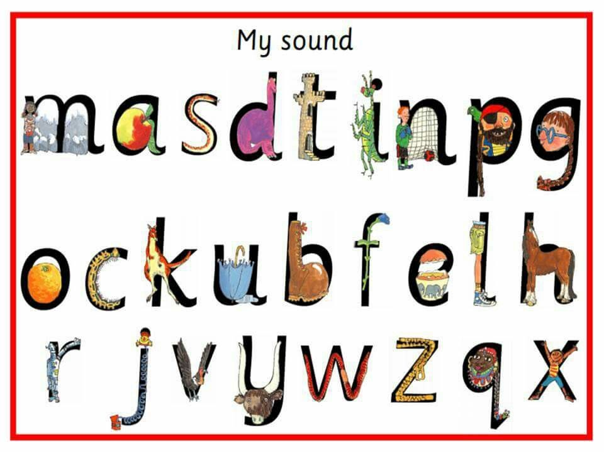
Pre-School Phonics
The Phonics journey starts in Pre-School
Firstly, the children learn the mnemonic ( a technique to improve memory) pictures
apple for a
boot for b
caterpillar for c and so on………
Secondly, the children learn the sound the letter makes
  We only use the ‘pure’ sound not the letter names

Slide 7
Understanding Read Write Inc.
In RWI the individual sounds are called Speed Sounds.
All words are made up of sounds, ( pure sounds) m not muh,
s, not suh, blended together this is called ‘Sound Blending’
How does it work??
  Children learn the 44 sounds and matching letters
  They learn to blend sounds to read words
  Read lots of specially written books
  This is DECODING
  Green Words are words you can blend
  RED words are words you cannot blend

Slide 8
(71) Parent video: How to say the sounds - YouTube

Slide 9

Reading journey - RWI
Children are split into developmentally
appropriate phonic groups. Taught to the necessary level and speed.
Children are assessed by the same person each half term and their group could change – very fluid groups.
They work in their group daily for approximately 30 minutes.
This continues into Year 1 and 2.

Slide 10
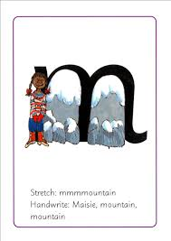
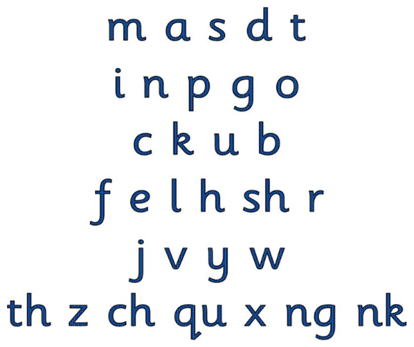
Speed Sounds
Set 1:-
Taught in daily intensive and fun sessions.
There is also a focus on the correct formation of the letters.

Slide 11
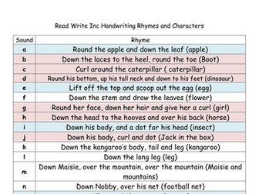
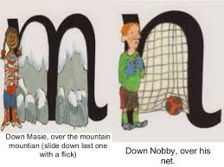
Forming letters
So important to form the letters properly and confidently.
A big focus in school with handwriting – this is the foundation.

Slide 12

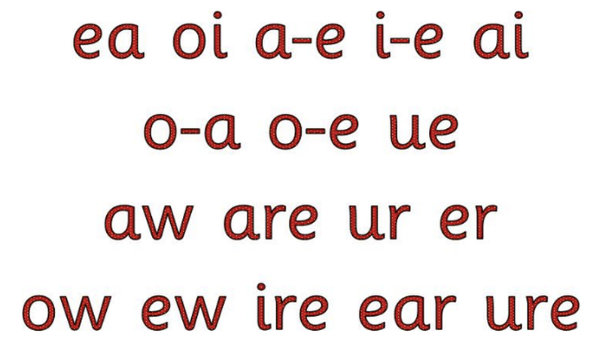
Speed Sounds Continued…..
As the children continue to progress, they will learn:-
Set 2
Set 3

Slide 13
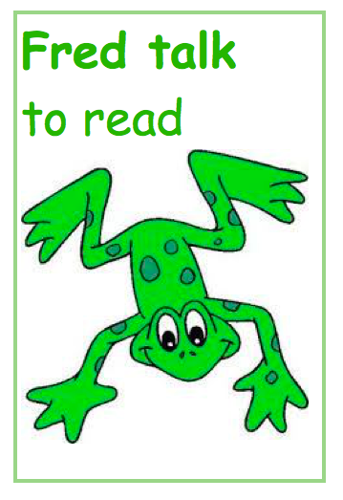
Meet Fred
Fred speaks differently
than you or I. He can only
Fred Talk.
c-a-t
d-o-g
sh-i-p
Can you hear the word?
Can you speak like Fred?
Notes:
On tables have word cards for parents to speak like Fred – work in partners.

Slide 14

Red Words-tricky words
I
the
my
he
she
These words cannot be sounded out correctly.

Slide 15
Writing using Read Write Inc.
Before children write words they use their Fred Fingers to hear the sounds then write them.

Slide 16
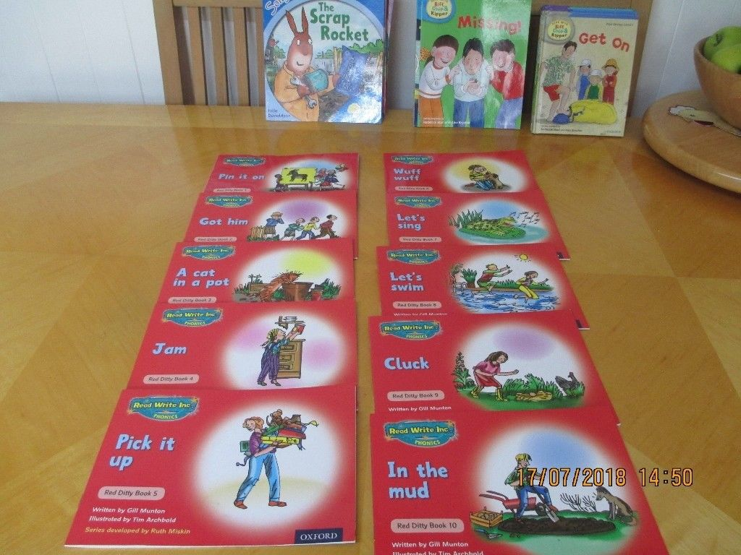
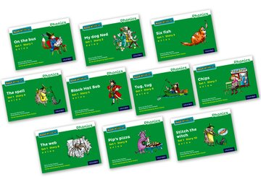
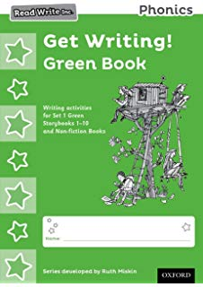
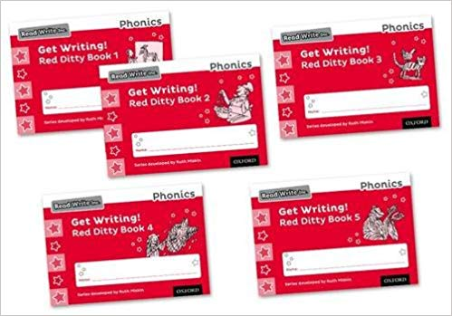
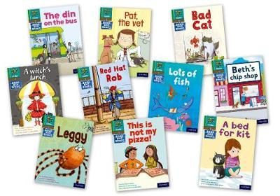
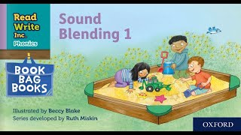
Following the Read Write Inc. Programme
These are some of the CORE story books we use in our RWI lessons.
Equivalent Writing book.
Equivalent Writing book.
Equivalent BOOK BAG books for HOME reading.
Notes:
Have examples of ditties on tables

Slide 17

www.oxfordowl.co.uk

Slide 18
Why does the extra read and practise Speed Sounds at home help so much??
Fluency
Understanding
Enjoyment
Confidence
Gain vocabulary knowledge

Slide 19
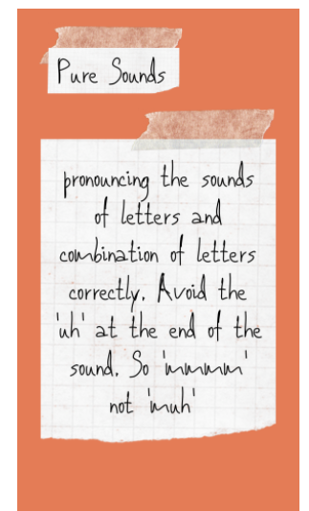
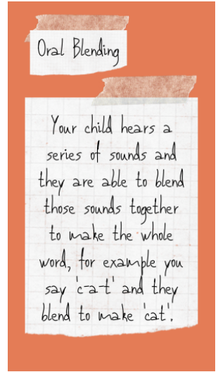
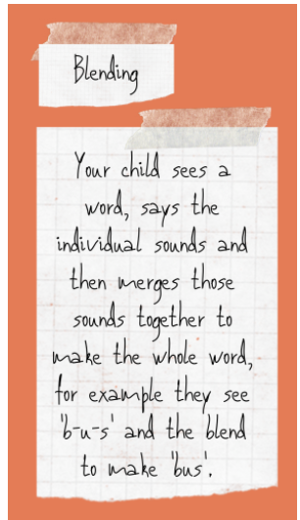
Jargon buster!

Slide 20
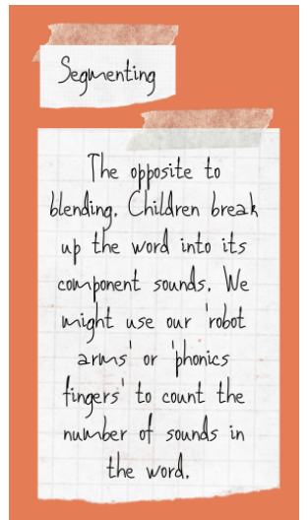
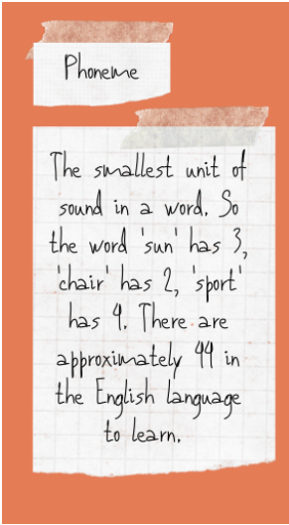
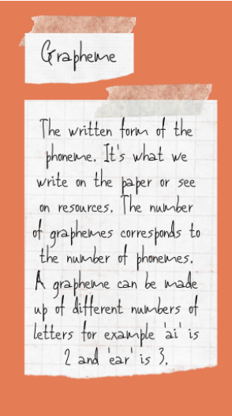
More jargon!

Slide 21
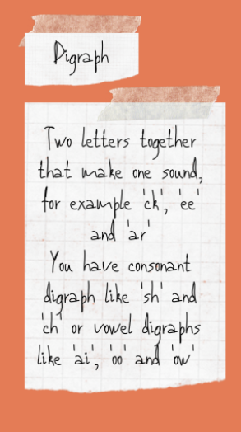
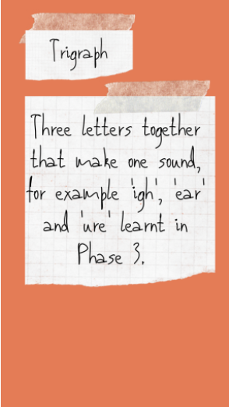
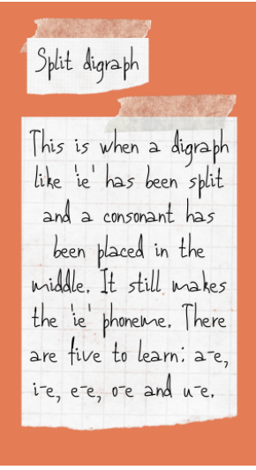
Even more jargon!

Slide 22
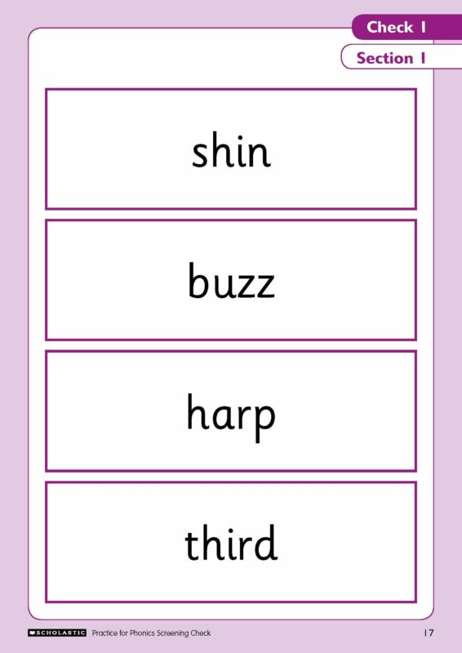
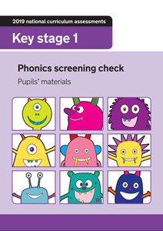

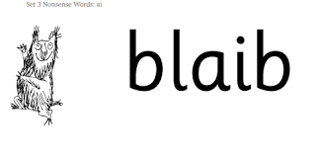

Phonics Screening Check –
JUNE
All Year 1 Pupils

Slide 23
At home – what you can do
Read stories together with
expression and fluency –ask comprehension questions
Encourage
Independent
Writing
Scrap books
Post cards to friends
Posters
Comics
Captions
Language
Act out your favourite story
Make puppets of characters
from a story
and put on a puppet show
Practise the RWI sounds learnt in school/Read the story book/Play Quizzes set on Oxford Owl.
Buy the Flash Cards **

Slide 24

Reading together
Its lovely to share a bedtime story!!
Remember, reading for pleasure
is what is important!!
Its not ‘all’ about Phonics.

